Slide 1
Recurrences
&
Master Method

Slide 2
The divide- and- conquer design paradigm
• Divide and conquer is just one of several powerful techniques for algorithm design
Recursion is a "Programming Paradigm" which is generally used to implement the "Algorithmic Paradigm" Divide and Conquer
• Divide- and- conquer algorithms can be analyzed using recurrences and the master method
  Performance of recursive algorithms typically specified with recurrence equations
  Recurrence equations require special techniques for solving
• Can lead to more efficient algorithms

Slide 3
Analyzing Performance of Non-Recursive vs Recursive Algorithms
Performance analysis of non-recursive algorithms are relatively easy
Performance analysis of recursive algorithms are not that easy
  Consider few recursive algorithms that you already known.
  Think how you could analyzed the performance
  What is the key question….?

Slide 4
The divide- and- conquer design paradigm
1. Divide the problem (instance) into sub-problems
2. Conquer the sub-problems by solving them recursively
3. Combine sub-problem solutions

Slide 5
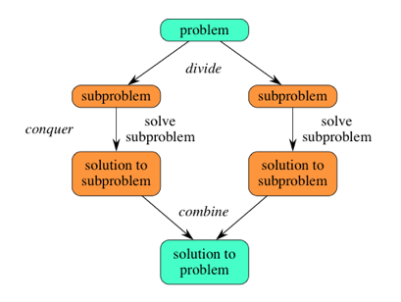
The divide- and- conquer design paradigm

Slide 6
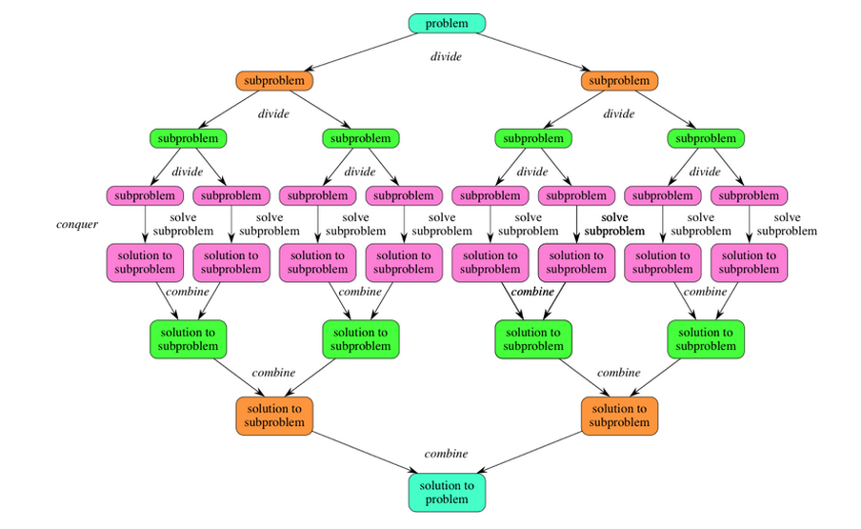
The divide- and- conquer design paradigm

Slide 7
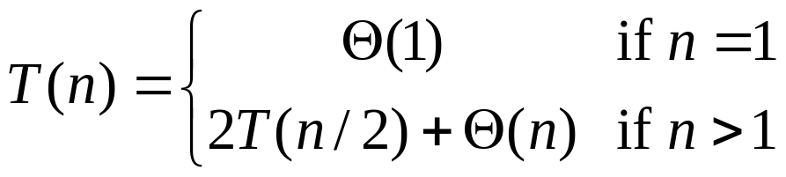
Recurrences
Running times of algorithms with recursive calls can be described using recurrences
A recurrence is an equation or inequality that describes a function in terms of its value on smaller inputs
For divide and conquer algorithms:
Example: Merge Sort

Slide 8
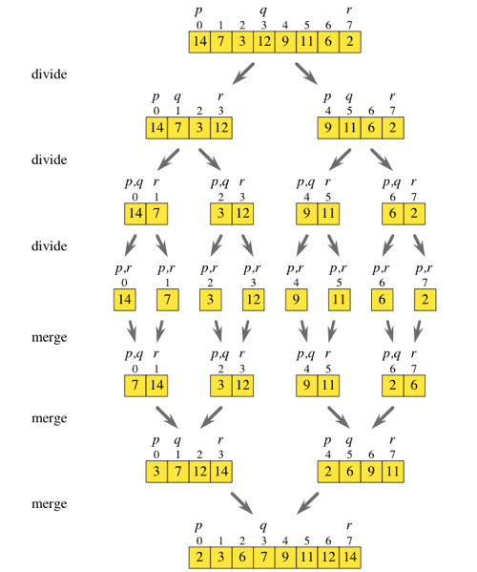
Merge Sort

Slide 9
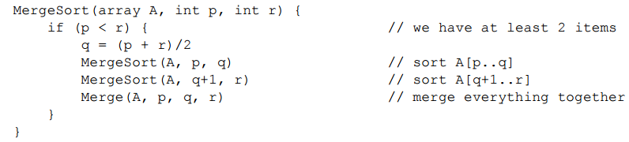
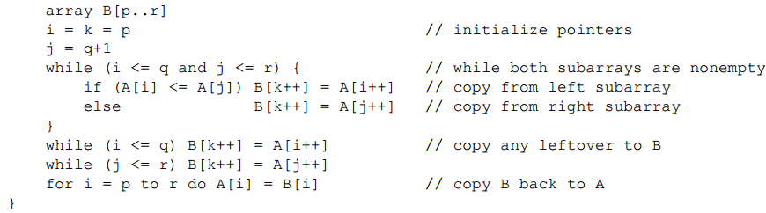
Merge Sort Pseudo-code

Slide 10
Merge Sort Simulation
Merge Sort Simulation
  http://www.ee.ryerson.ca/~courses/coe428/sorting/mergesort.html

Slide 11
Merge Sort Pseudo-code
Constant time = c1
T(n/2)
T(n/2)
C2*n + C3

Slide 12
The divide- and- conquer design paradigm
Example: merge sort
1. Divide: Trivial (array is halved).
2. Conquer: Recursively sort 2 sub-arrays.
3. Combine: Linear- time merge.
Recurrence for merge sort
Let T( n ) = Time required for size n
T( n ) =
Sub-problem
Size (n/2)
2
*
T( n / 2)
+
O( n)
Number Of Subproblems
Time required for each Subproblem
Work Dividing and Combining
*
+

Slide 13
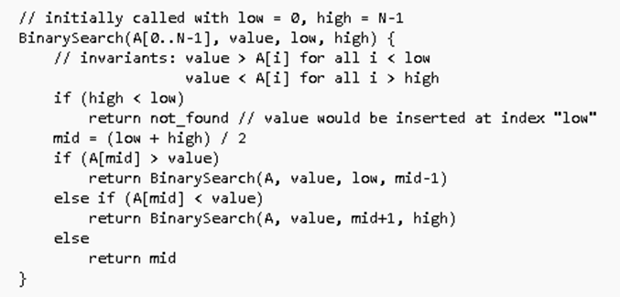
Binary Search

Slide 14
The divide- and- conquer design paradigm
Binary search
Find an element in a sorted array:
1. Divide: Check middle element
2. Conquer: Recursively search 1 sub-array
3. Combine: Trivial
Recurrence for binary search
T( n) =
1
*
T( n / 2)
+
Θ(1)
Number Of Subproblems
Time required for each Subproblem
Work Dividing and Combining
*
+

Slide 15
Solving Recurrences
Repeated (backward) substitution method
  Expanding the recurrence by substitution and noticing a pattern (this is not a strictly formal proof).
Substitution method
  guessing the solutions
  verifying the solution by the mathematical induction
Recursion-trees
Master method
  templates for different classes of recurrences

Slide 16
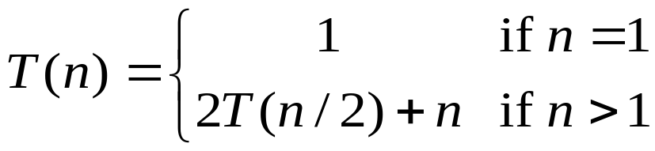
Repeated Substitution
Let’s find the running time of the merge sort
T(n) = 2T(n/2) + n substitute
= 2(2T(n/4) + n/2) + n expand
= 2²T(n/4) + 2n substitute
= 2²(2T(n/8) + n/4) + 2n expand
= 2³T(n/8) + 3n observe pattern
= 2³T(n/2³) + 3n observe pattern
T( n ) = 2^{k}T(n/2^{k}) + kn
= n T(n/n) + n lg n
= n + n lg n
assume 2^{k-1}< n ≤ 2^{k}.
So upper bound for k is
n = 2^{k}
K = log₂n = lg n
T(n) = O(nlgn)

Slide 17
Repeated Substitution Method
The procedure is straightforward:
  Substitute, Expand, Substitute, Expand, …
  Observe a pattern and determine the expression after the k-th substitution.
  Find out what the highest value of k (number of iterations, e.g., lg n) should be to get to the base case of the recurrence (e.g., T(1)).
  Insert the value of T(1) and the expression of k into your expression.

Slide 18
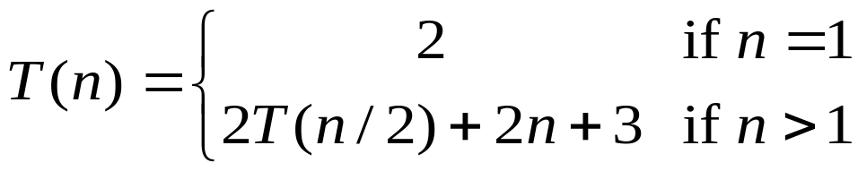

Another Example…
assume 2^{k-1}< n ≤ 2^{k}.
So upper bound for k is
n = 2^{k}
K = log₂n = lg n
T(n) = 2T(n/2) + 2n + 3 substitute
= 2(2T(n/4) + n + 3) + 2n +3 expand
= 2²T(n/4) + 4n + 2x3 + 3 substitute
= 2²(2T(n/8) + n/2 + 3) + 4n + 2x3 + 3 expand
= 2³T(n/2³) + 2x3n + 3x(2²⁺2¹⁺2⁰) observe pattern
T(n) = 2^{k}T(n/2^{k}) + 2nk + 3
= 2^{k}T(n/2^{k}) + 2nk + 3 (2^{k}-1)
= nT(n/n) + 2n lg n + 3(n - 1)
= 2n+2n lg n + 3n - 3
= 5n + 2n lg n – 3
T(n) = O(nlgn)

Slide 19

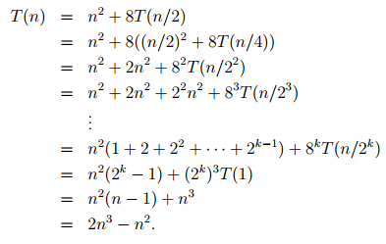
Exercise: Repeated Substitution

Slide 20
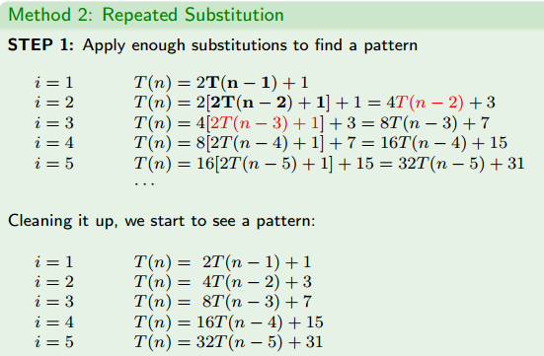

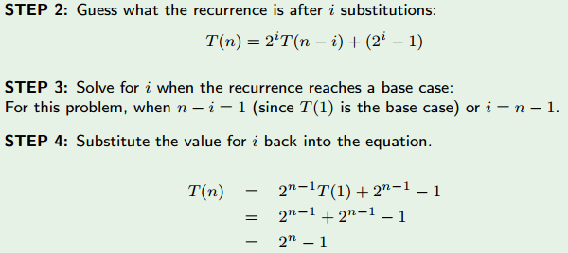
Exercise: Repeated Substitution

Slide 21
Substitution Method
The substitution method to solve recurrences entails two steps:
  Guess the solution.
  Use induction to prove the solution.
Example:
  T(n) = 4T(n/2) + n

Slide 22
…Substitution Method
T(n) = 4T(n/2) + n
1) Guess T(n) = O(n³), i.e., T(n) is of the form cn³
2) Prove T(n) ≤ cn³ by induction
T(n) = 4T(n/2) + n recurrence
≤ 4c(n/2)³ + n induction hypothesis
= 0.5cn³ + n simplify
= cn³ – (0.5cn³ – n) rearrange
≤ cn³ if c>=2 and n>=1
Thus T(n) = O(n³)

Slide 23
...Substitution Method
Tighter bound for T(n) = 4T(n/2) + n:
Try to show T(n) = O(n²)
Prove T(n) ≤ cn² by induction
T(n) = 4T(n/2) + n
≤ 4c(n/2)² + n
= cn² + n
≤ cn²

Slide 24
...Substitution Method
What is the problem? Rewriting
  T(n) = O(n²) = cn² - (something positive)
As T(n) ≤ cn² does not work with the inductive proof.
Solution: Strengthen the hypothesis for the inductive proof:
  T(n) ≤ (answer you want) - (something > 0)

Slide 25
...Substitution Method
Fixed proof: strengthen the inductive hypothesis by subtracting lower-order terms:
Prove T(n) ≤ cn² - dn by induction
T(n) = 4T(n/2) + n
≤ 4(c(n/2)² – d(n/2)) + n
= cn² – 2dn + n
= (cn² – dn) – (dn – n)
≤ cn² – dn if d ≥ 1

Slide 26
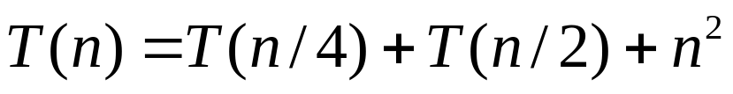
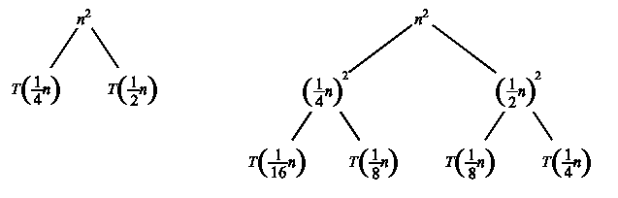
Recursion Tree
A recursion tree is a convenient way to visualize what happens when a recurrence is iterated.
  Good for ”guessing” asymtotic solutions to recurrences

Slide 27
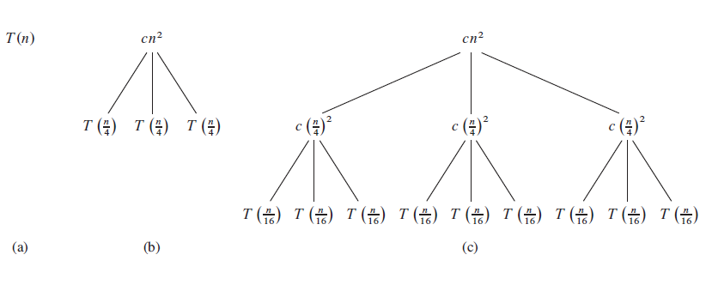

Slide 28
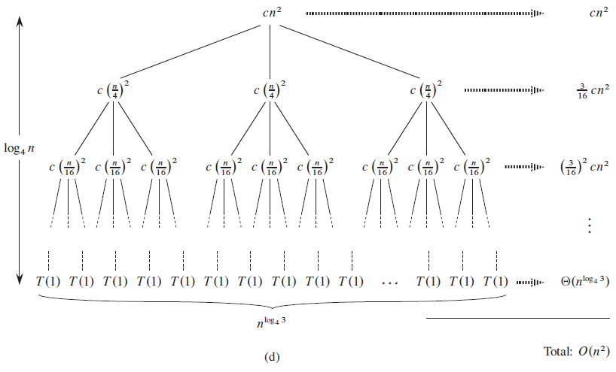

Slide 29
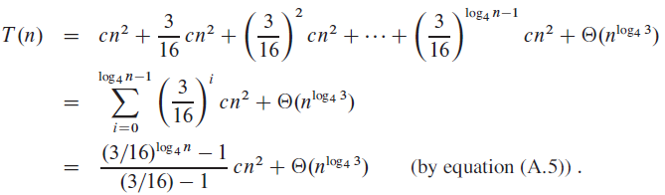
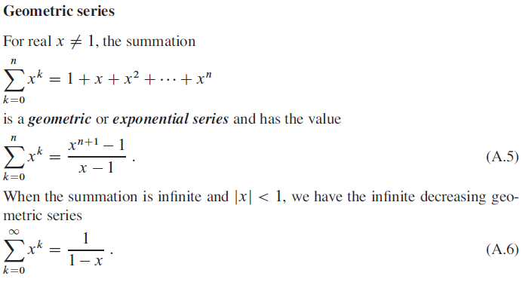

Slide 30
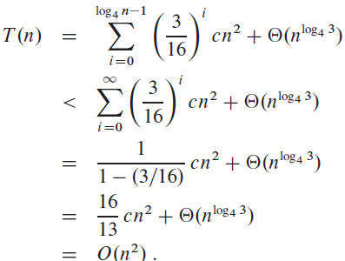

Slide 31
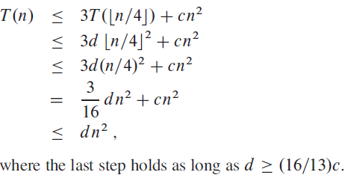
Verify our guess [substitution]

Slide 32

Master Method
The idea is to solve a class of recurrences that have the form
T(n) = aT(n/b) + f(n)
Assumptions: a ≥ 1 and b > 1, and f(n) is asymptotically positive.
Abstractly speaking, T(n) is the runtime for an algorithm and we know that
  a number of subproblems of size n/b are solved recursively, each in time T(n/b).
  f(n) is the cost of dividing the problem and combining the results. e.g., In merge-sort .

Slide 33
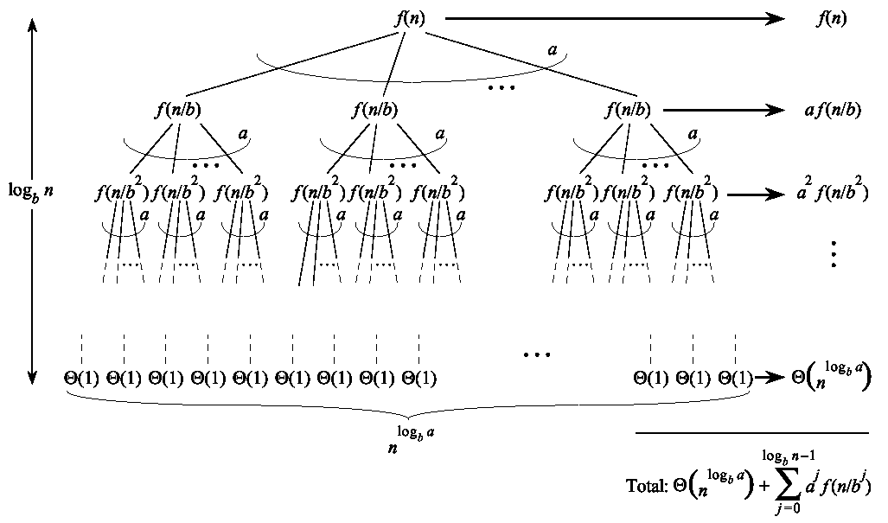


…Master Method
Split problem into a parts. There are
log_{b}n levels. There are leaves.

Slide 34
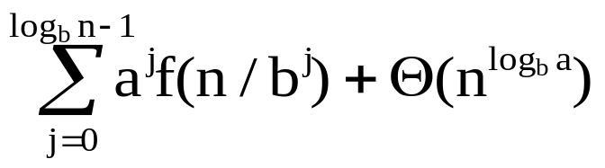
…Master Method
Iterating the recurrence (expanding the tree) yields
T(n) = f(n) + aT(n/b)
= f(n) + af(n/b) + a²T(n/b²)
= f(n) + af(n/b) + a²f(n/b²) + …
a^{log}b^{n-1}f(n/b^{log}b^{n-1}) + a^{log}b^{n}T(1)
T(n) =
The first term is a division/recombination cost (totaled across all levels of the tree).
The second term is the cost of doing all subproblems of size 1 (total of all work pushed to leaves).

Slide 35
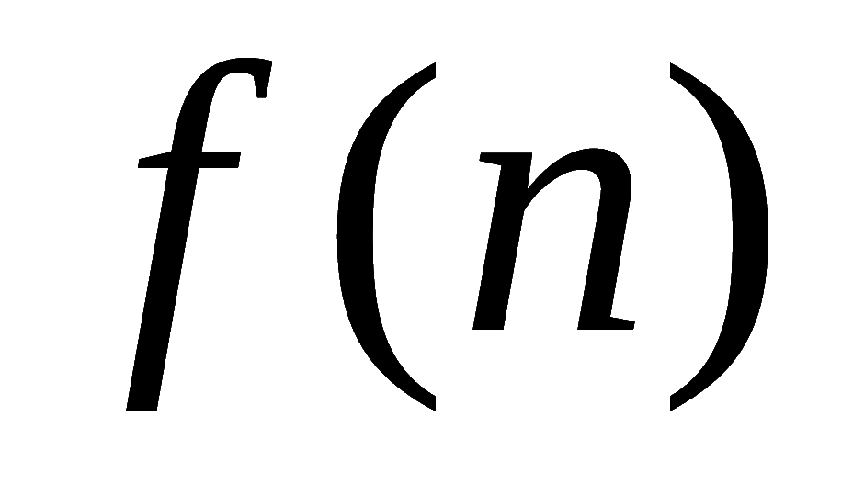
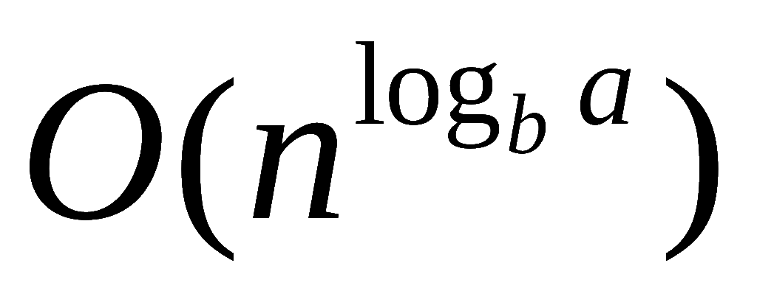
Master Method, Intuition
Three common cases:
  Running time dominated by cost at leaves.
  Running time evenly distributed throughout the tree.
  Running time dominated by cost at the root.
To solve the recurrence, we need to identify the dominant term.
In each case compare with

Slide 36
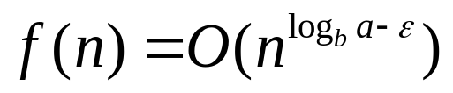

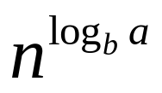
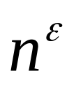
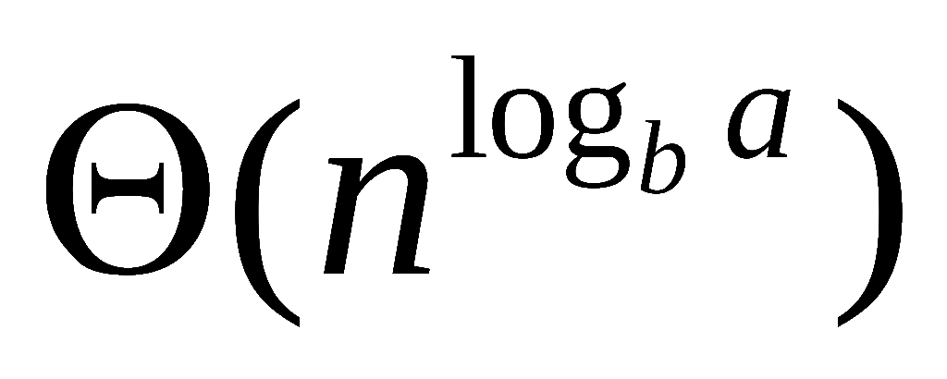
Master Method, Case 1
If for some constant then
  f(n) grows polynomially slower than (by factor ).
The work at the leaf level dominates
  Cost of all the leaves

Slide 37
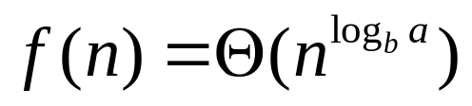
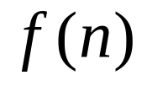
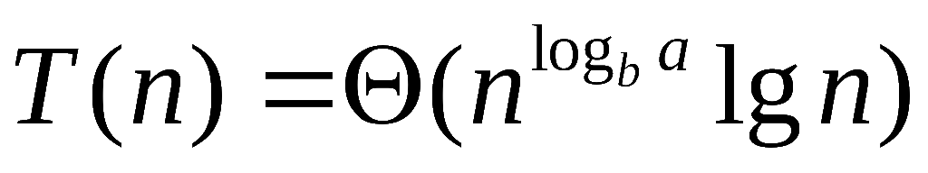
Master Method, Case 2
If then
  and are asymptotically the same
The work is distributed equally throughout the tree
      (level cost)(number of levels)

Slide 38
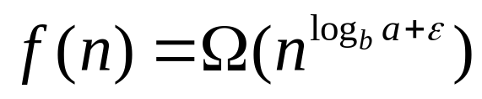
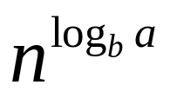
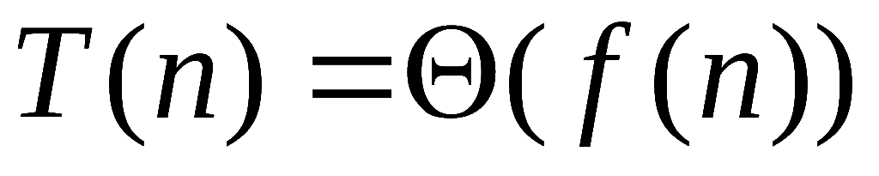
Master Method, Case 3
If for some constant then
  Inverse of Case 1
  f(n) grows polynomially faster than
  Also need a “regularity” condition
The work at the root dominates
  division/recombination cost

Slide 39
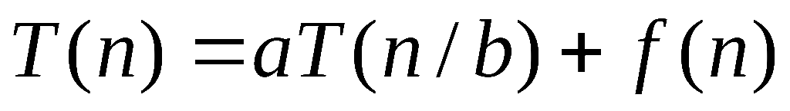
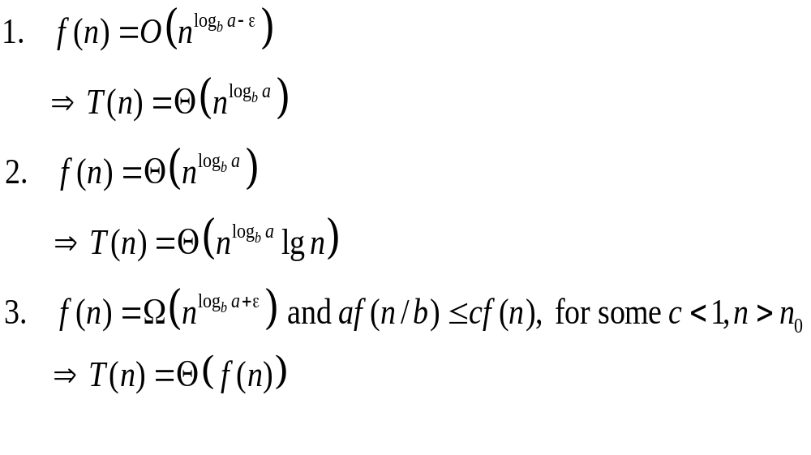
Master Theorem, Summarized
Given: recurrence of the form

Slide 40
Strategy
Extract a, b, and f(n) from a given recurrence
Determine n^{log}b ª
Compare f(n) and n^{log}b ª asymptotically
Determine appropriate MT case and apply it
Merge sort: T(n) = 2T(n/2) + Θ(n)
1. a=2, b=2, f(n) = Θ(n)
2. n^{log}2² = n
3. Θ(n) = Θ(n)
➔ Case 2: T(n) = Θ(n^{log}bªlog n) = Θ(n log n)

Slide 41
Examples of Master Method
BinarySearch(A, l, r, q):
m := (l+r)/2
if A[m]=q then return m
else if A[m]>q then
BinarySearch(A, l, m-1, q)
else BinarySearch(A, m+1, r, q)
T(n) = T(n/2) + 1
1. a=1, b=2, f(n) = 1
2. n^{log}2¹ = 1
3. 1 = Θ(1)
➔ Case 2: T(n) = Θ(log n)

Slide 42
...Examples of Master Method
T(n) = 9T(n/3) + n
1. a=9, b=3, f(n) = n
2. n^{log}3⁹ = n²
3. n = Θ(n^{log}3^{9 - ε}) with ε = 1
➔ Case 1: T(n) = Θ(n²)

Slide 43
...Examples of Master Method
T(n) = 3T(n/4) + n log n
1. a=3, b=4, f(n) = n log n
2. n^{log}4³ = n^{0.792}
3. n log n = Ω(n^{log}4^{3 + ε}) with ε = 0.208
➔ Case 3:
regularity condition: af(n/b) <= cf(n)
af(n/b) = 3(n/4)log(n/4) <= (3/4)nlog n = cf(n) ;with c=3/4
T(n) = Θ(n log n)

Slide 44
References & Readings
CLRS
  Chapter: 4 (4.1-4.3)
  4.4 for bedtime reading
  Exercises
    4.1, 4.2, 4.3
  Problems
    4-1, 4-4
HSR
  Chapter: 3 (3.1-3.6)
  Examples: 3.1-3.5
  Exercises: 3.1 (1, 2), 3.2 (1, 3-6),

